Slide 1
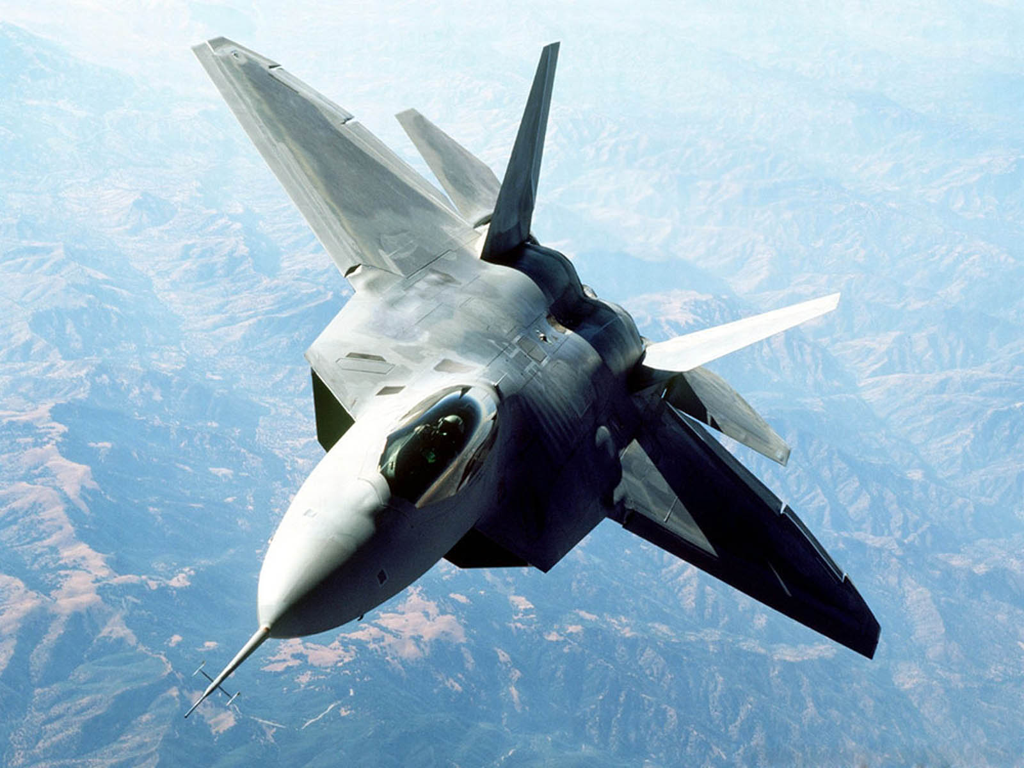
Jet Fighter
Combat Flight Game

Slide 2
Objectives
Introduction
System
Intended Use
Benefits
Points of Interest

Slide 3
About The Game
Developed by
Eric Goettl
Game Engine
Phaser game engine
Concept
Vertical scroller based off games like Top Gun, and Space Invaders.

Slide 4
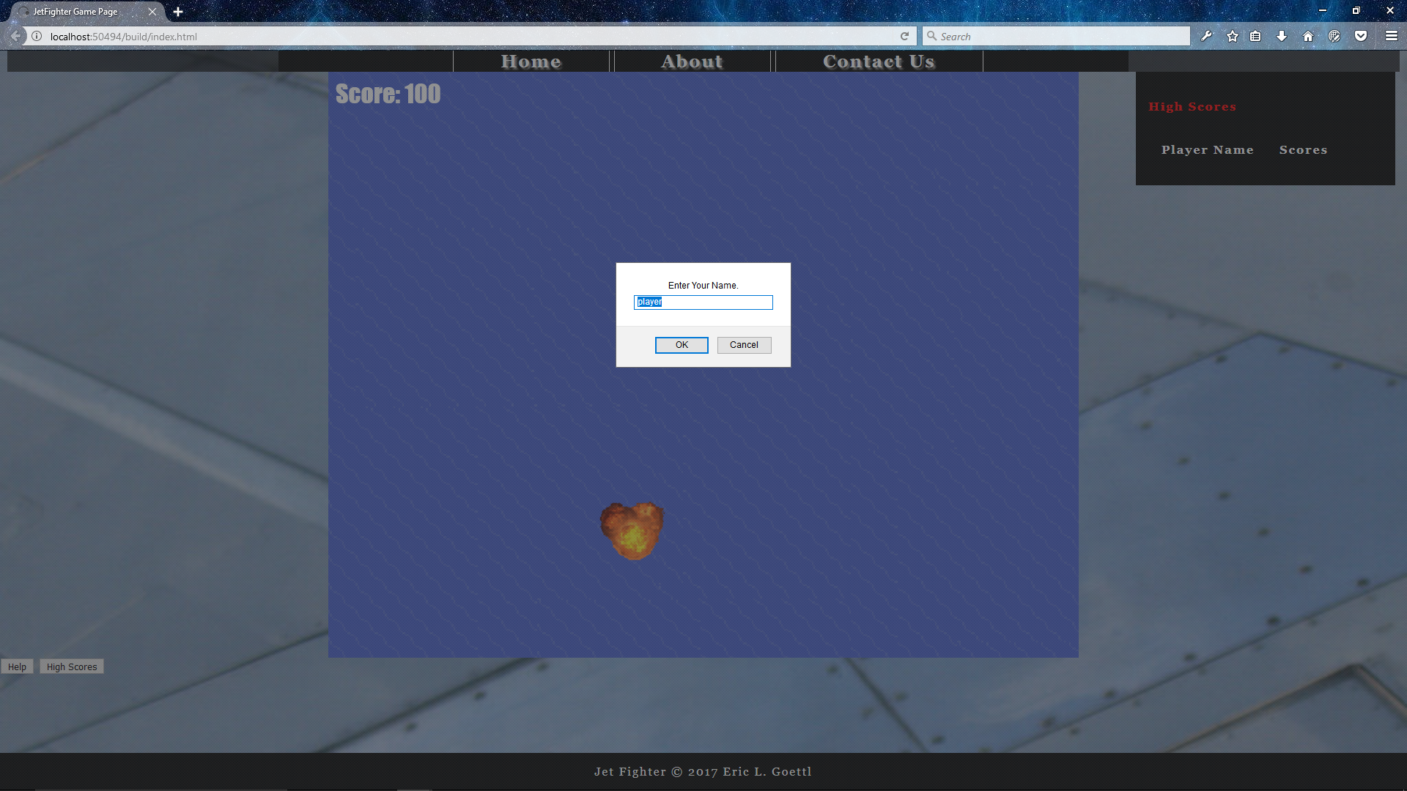
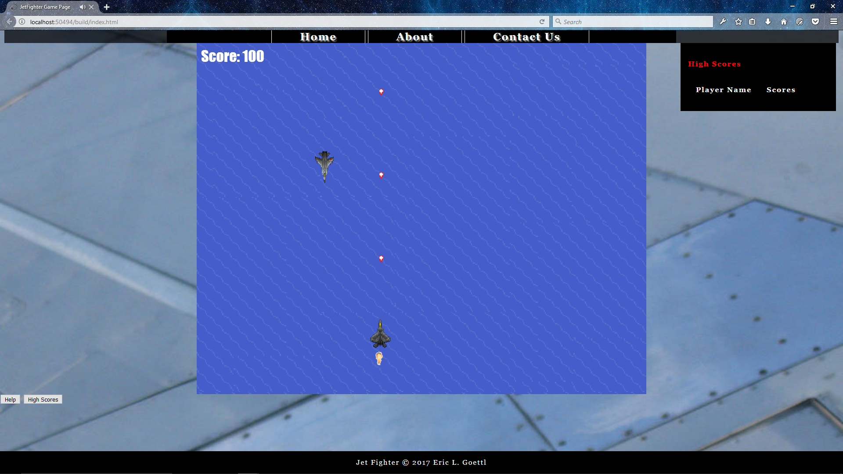
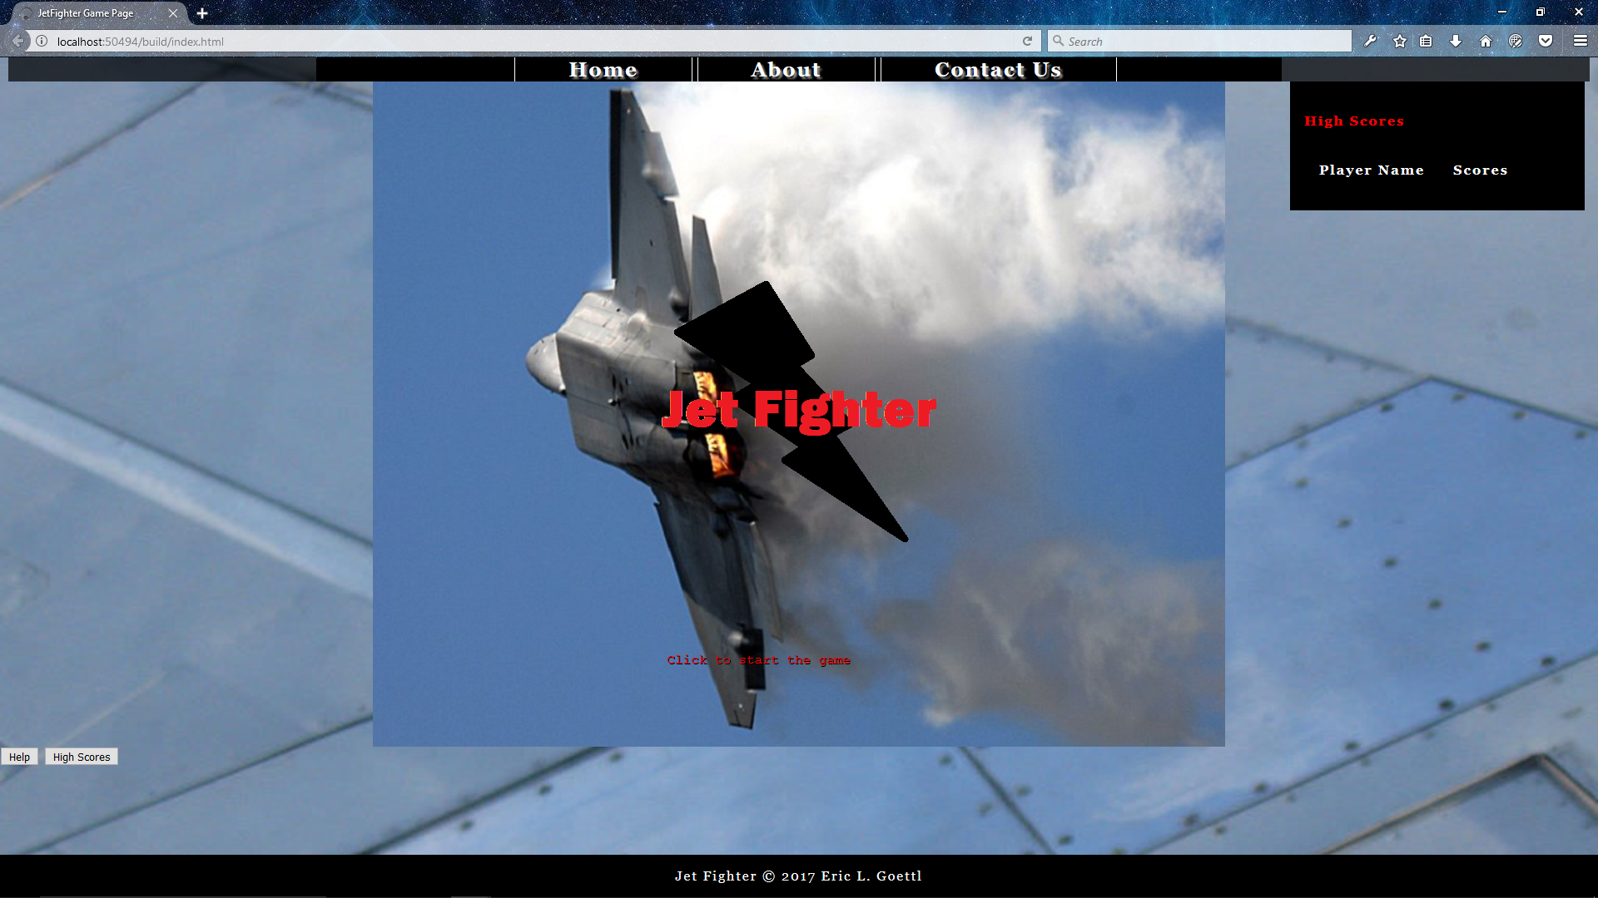
System
Phaser Game Engine
Web based
Open source
Uses Canvas & WebGL

Slide 5
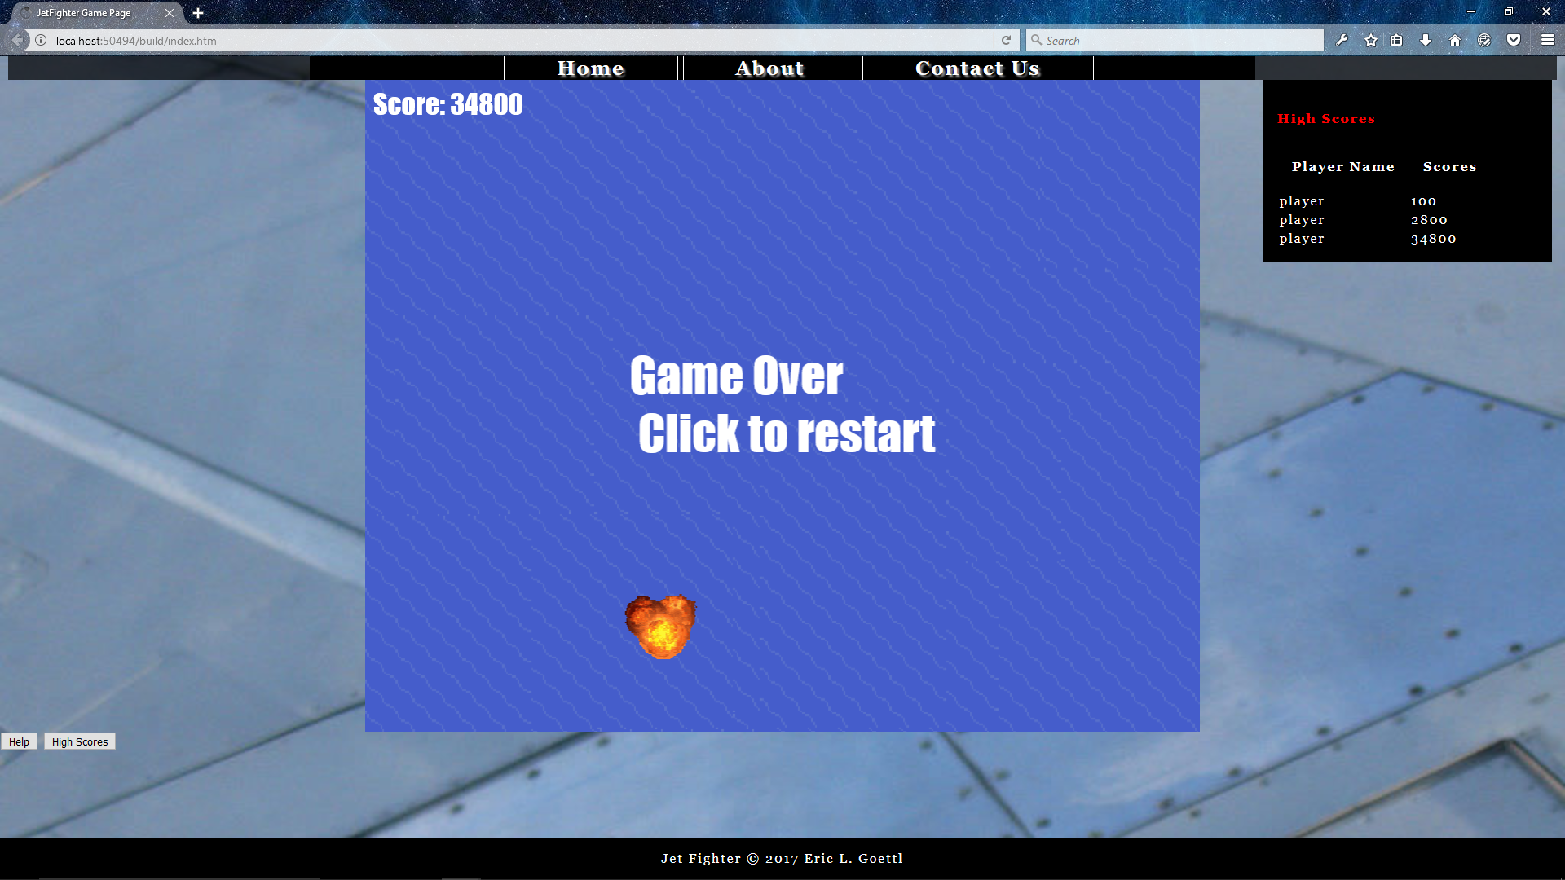
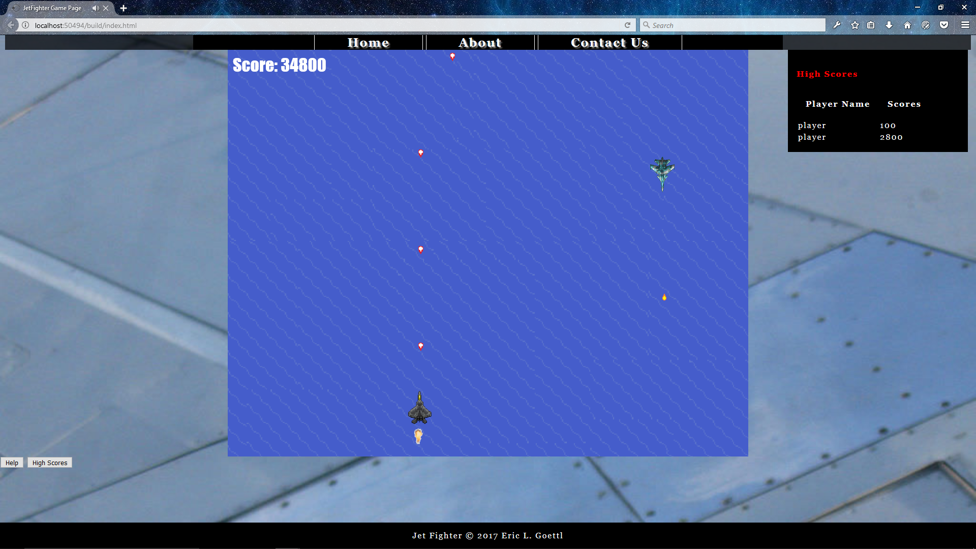
Intended Use
Arcade Based Audience
Fun web based game with no downloads needed.
For use as a marketing tool for future projects, and game development.

Slide 6

Benefits
Lightweight application.
Virtually no use of local hard disk space.
Runs as JavaScript, and HTML.
Can be modified for cross platform.

Slide 7
Points of Interest
Animations and explosions.
Sound effects.
Player score displayed right on the load screen.
Multiple levels, getting more challenging as you go.
Tough boss fight.
Missile and cannon firing.

Slide 8
Conclusion
Jet Fighter is a great game for the arcade crowd.
Lightweight
Challenging to play.

Slide 9
Conclusion
Jet Fighter is a great game for the arcade crowd.
Lightweight
Challenging to play.
QUESTIONS?

